Slide 1
Team Members:
Varun Panchal – 18R21A05H8
Jathod Pavan – 18R21A05E3
B Abhishek – 18R21A05C7
Sai Teja – 18R21A05E4
Guided By:
Ms. D Divya Priya

Slide 2
Agenda
Introduction
Literature Survey
Proposed Method
Modules and Algorithm

Slide 3
Introduction
We know Google Drive is a File Storage and Synchronization Service developed by Google
One of the major problem while downloading Shared folder from Google Drive with browser is, The browsers actually cannot download the folder itself.
One more issue is that if the folder size exceeds more than 2 Giga bytes the Google drive will produce multiple extractable files of the same folder
GOOGLE DRIVE
ZIPPING
EXTRACTING
LOCAL DRIVE

Slide 4
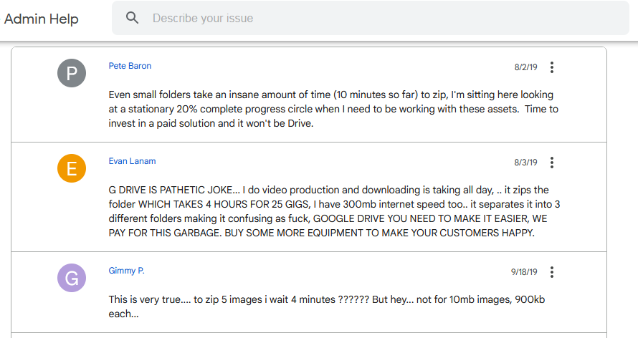
https://support.google.com/a/thread/8324573/why-is-drive-so-slow-to-download-into-a-zip?hl=en

Slide 5
Literature Survey
Google Drive for Desktop App
Chooses folders on your computer to sync with Google Drive or backup to Google Photos, and access all of your content directly from your PC or Mac.
But the disadvantage here it is that it will not give access to those folders which are been shared to us or the public

Slide 6
Proposed Method
Our objective is to make a tool which can skip the zipping process of the browser
With the help of the tool a user can save time without waiting for the folder to get compressed
It also saves work for the user by not wasting time on extracting the files to get the exact shared folder from Google drive
A Desktop application which is going to solve this problem by taking the input as the URL of the shared folder from Google Drive.
The application will have a progress bar which shows the progress and as well as a list view for the details of files in that folder

Slide 7
Modules
Google Drive API
The Google Drive API allows you to create apps that leverage Google Drive cloud storage. You can develop applications that integrate with Google Drive, and create robust functionality in your application using Google Drive API.
OAuth 2.0
The authorization protocol that Google Drive API requires to authenticate your app users. If your application uses Google Sign-in, it handles the OAuth 2.0 flow and application access tokens.

Slide 8
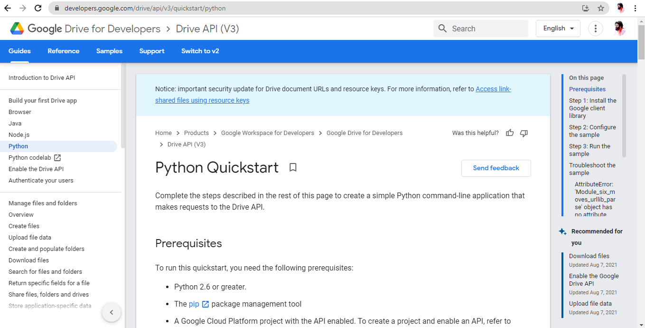

Slide 9
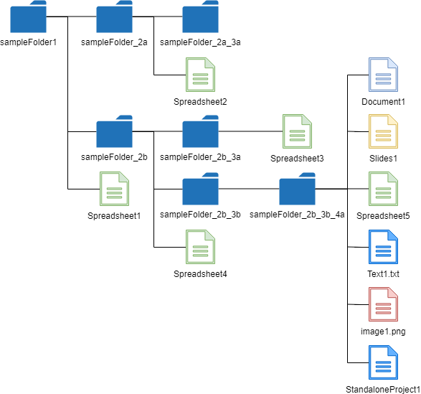
Algorithm

Slide 10
GUI Framework
PyQt5
It is a library that lets you use the Qt GUI framework from Python. Qt itself is written in C++. By using it from Python, you can build applications much more quickly.
Also, Qt comes with Qt Designer, a tool that acts as a graphical user interface. PyQt can design Python code from Qt Designer, while adding new GUI controls when both Qt Designer and Python programming language are used.

